Slide 1
The story
The extreme weather blankets the city in white, confining people to their homes. The new security staff member (female, 25) becomes the sole person the entire building can rely on. Her line manager pressures her to profit by selling government-issued supplies meant to be free to those in need. While she is unsure how to handle the situation, a young boy(13), accidentally left at home by his parents, overhears the phone conversation. When one lie is made, many lies follows.

Slide 2
Character (point of view)
24 year old female guard woman
13 year old boy
Neighbor (female, around 40)

Slide 3
TWO major settings
Corridor
One elevator for two household on each level
Two doors face to face
Monitor Room
Multiple computers, lots of screens

Slide 4
Corridor
Family 1
Stairs
platform
Window
Elevator
Family 2

Slide 5
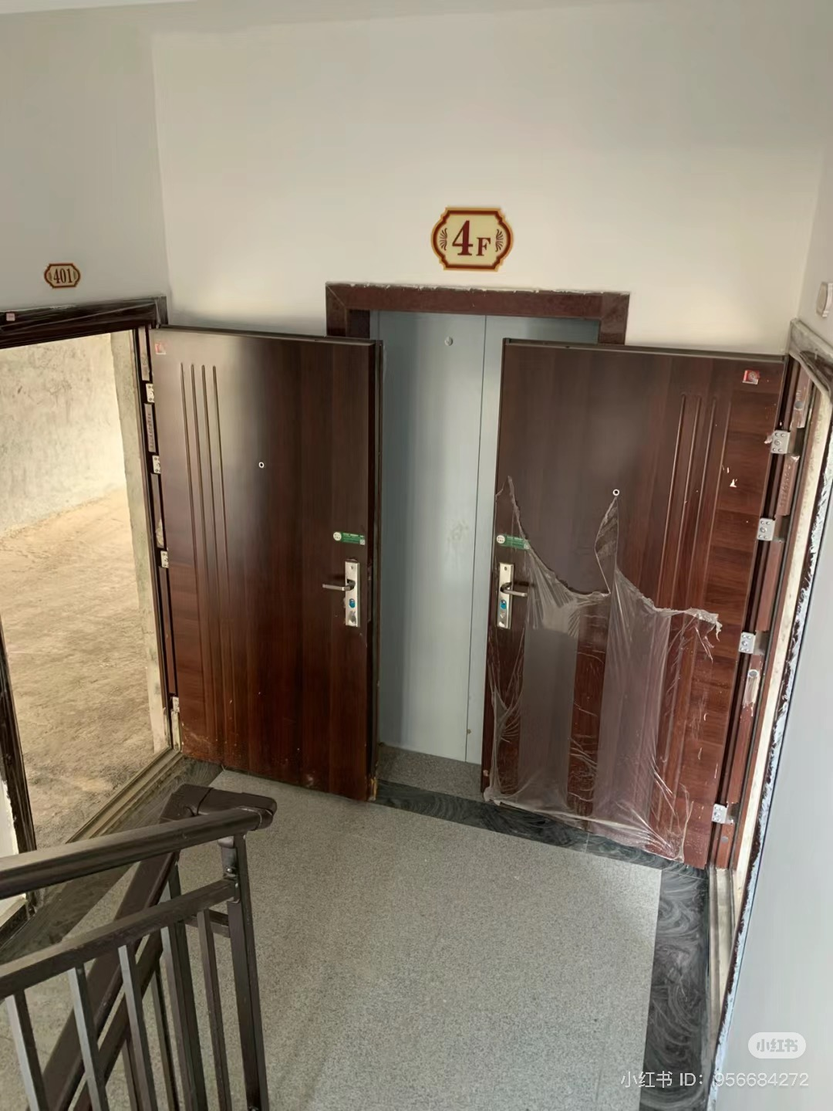
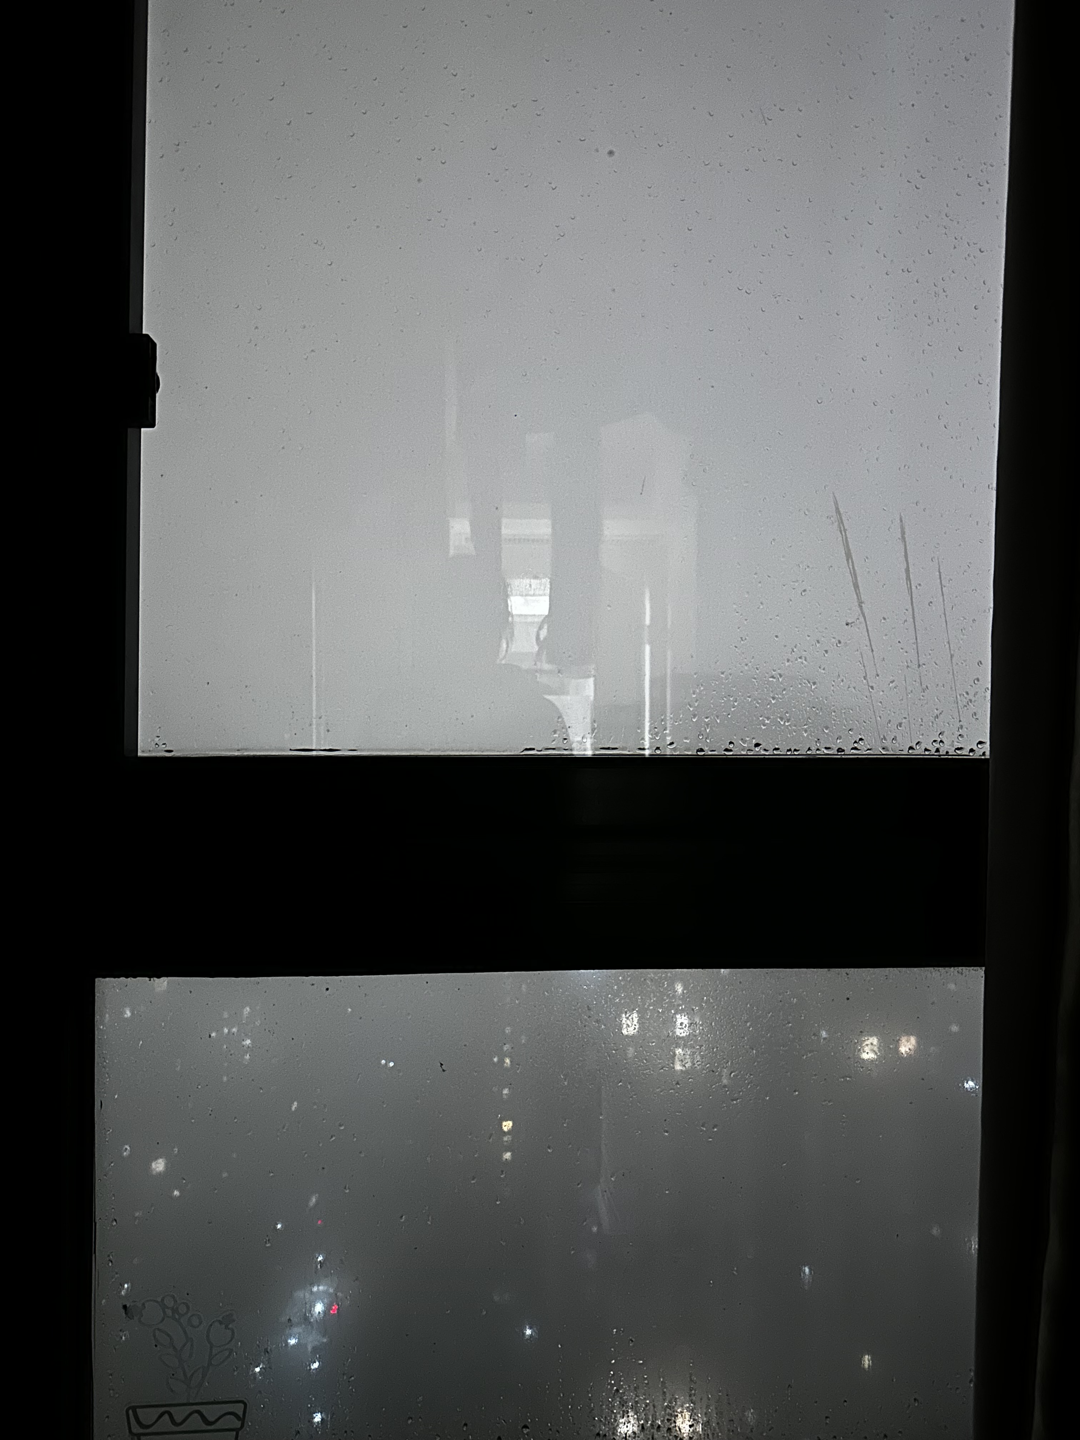
Visual reference
Fogged Window

Slide 6
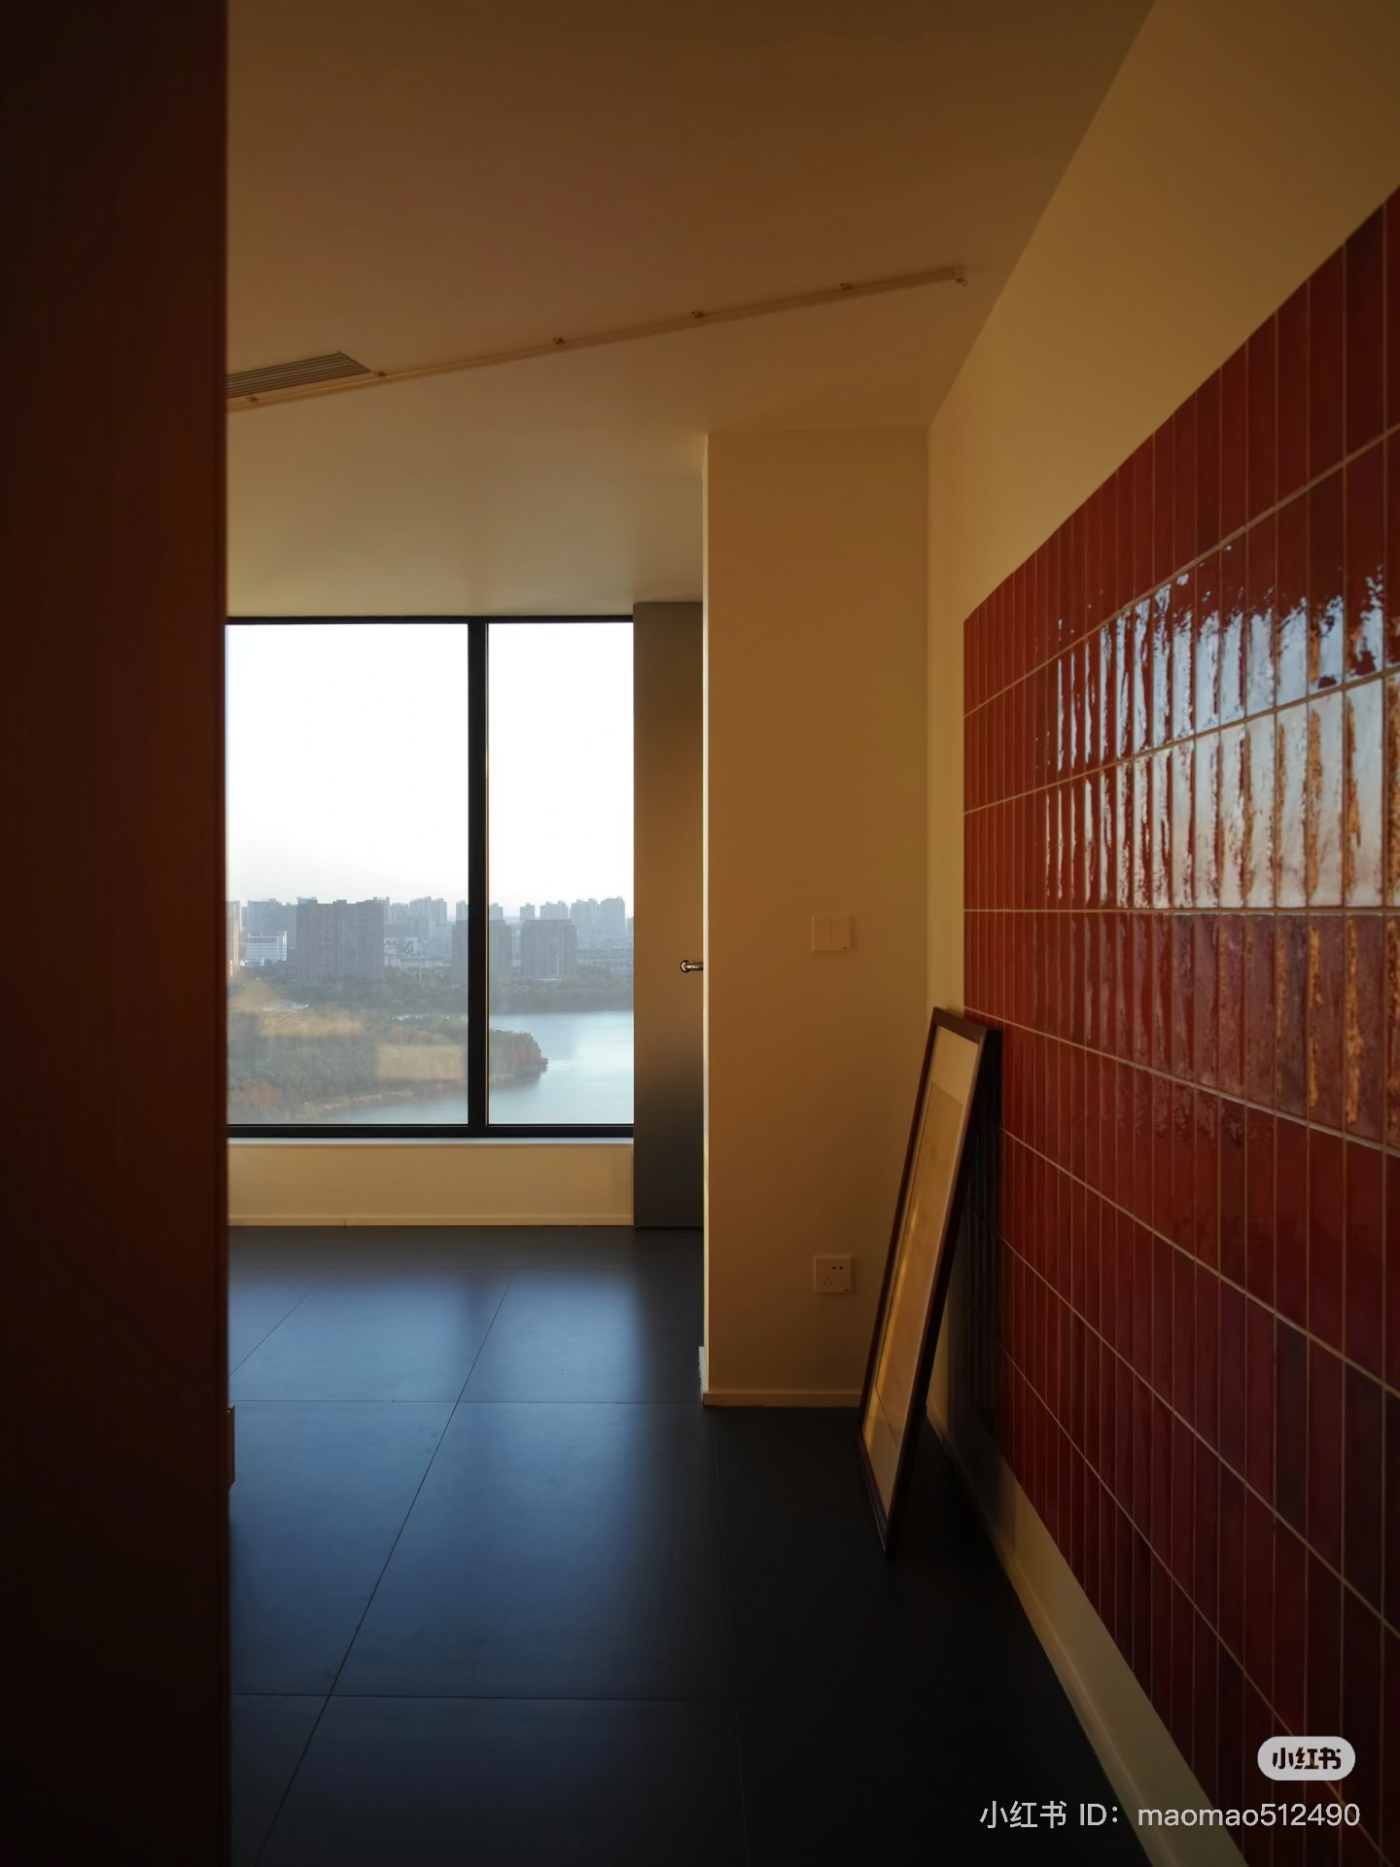
Colour
Doors: dark red, wooden
Tiled Wall: reflective
Yellow warm colour,

Slide 7
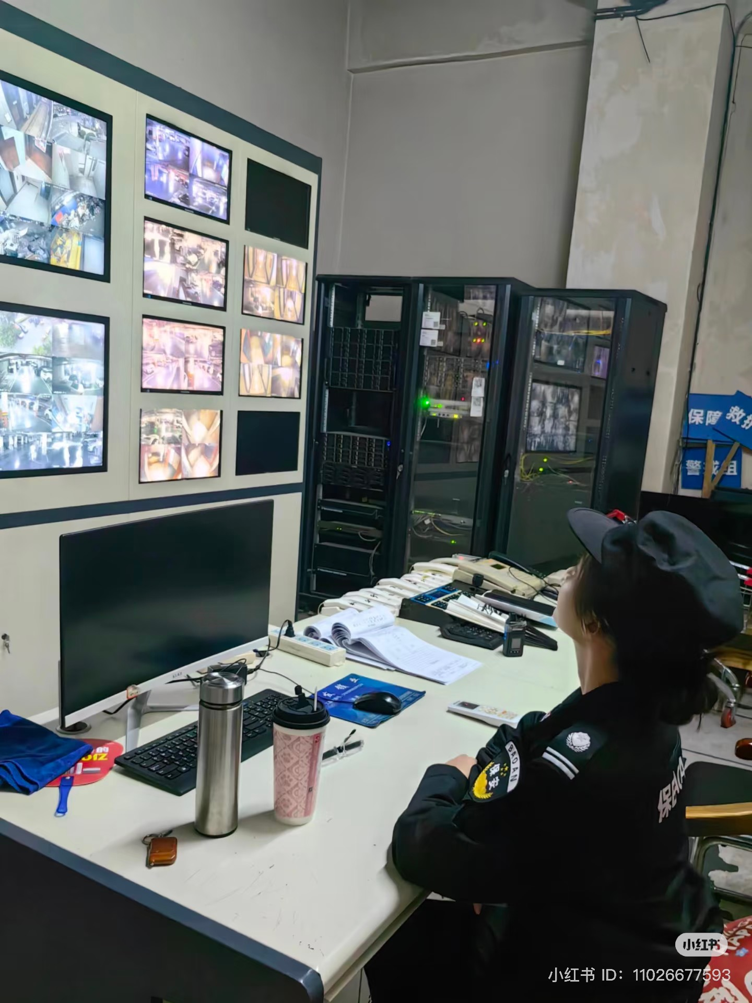
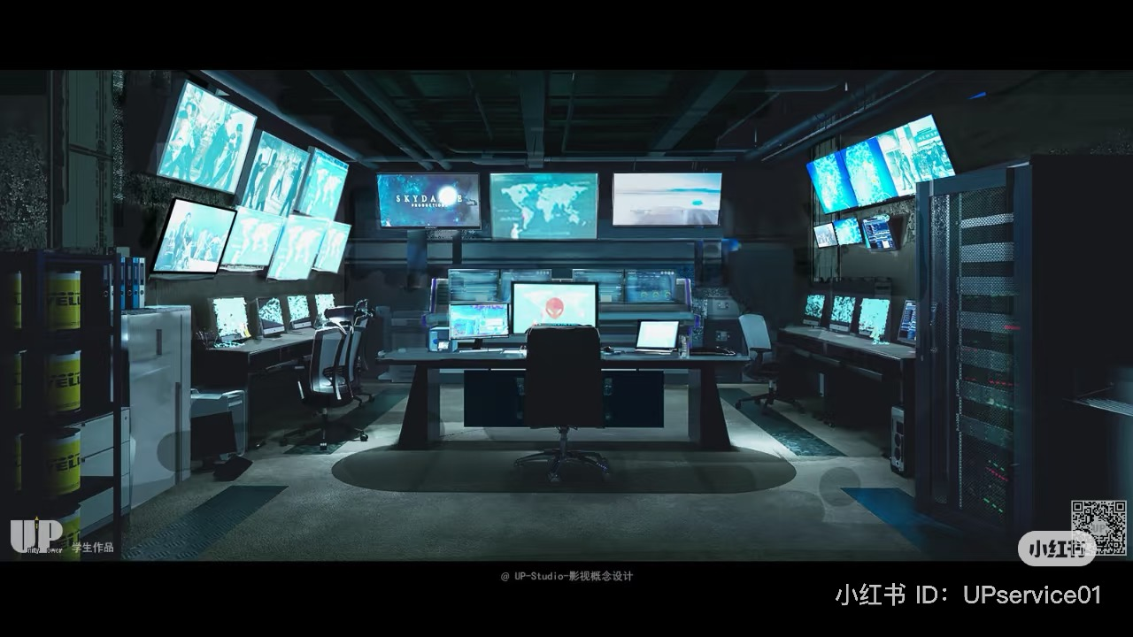
Monitor room

Slide 8
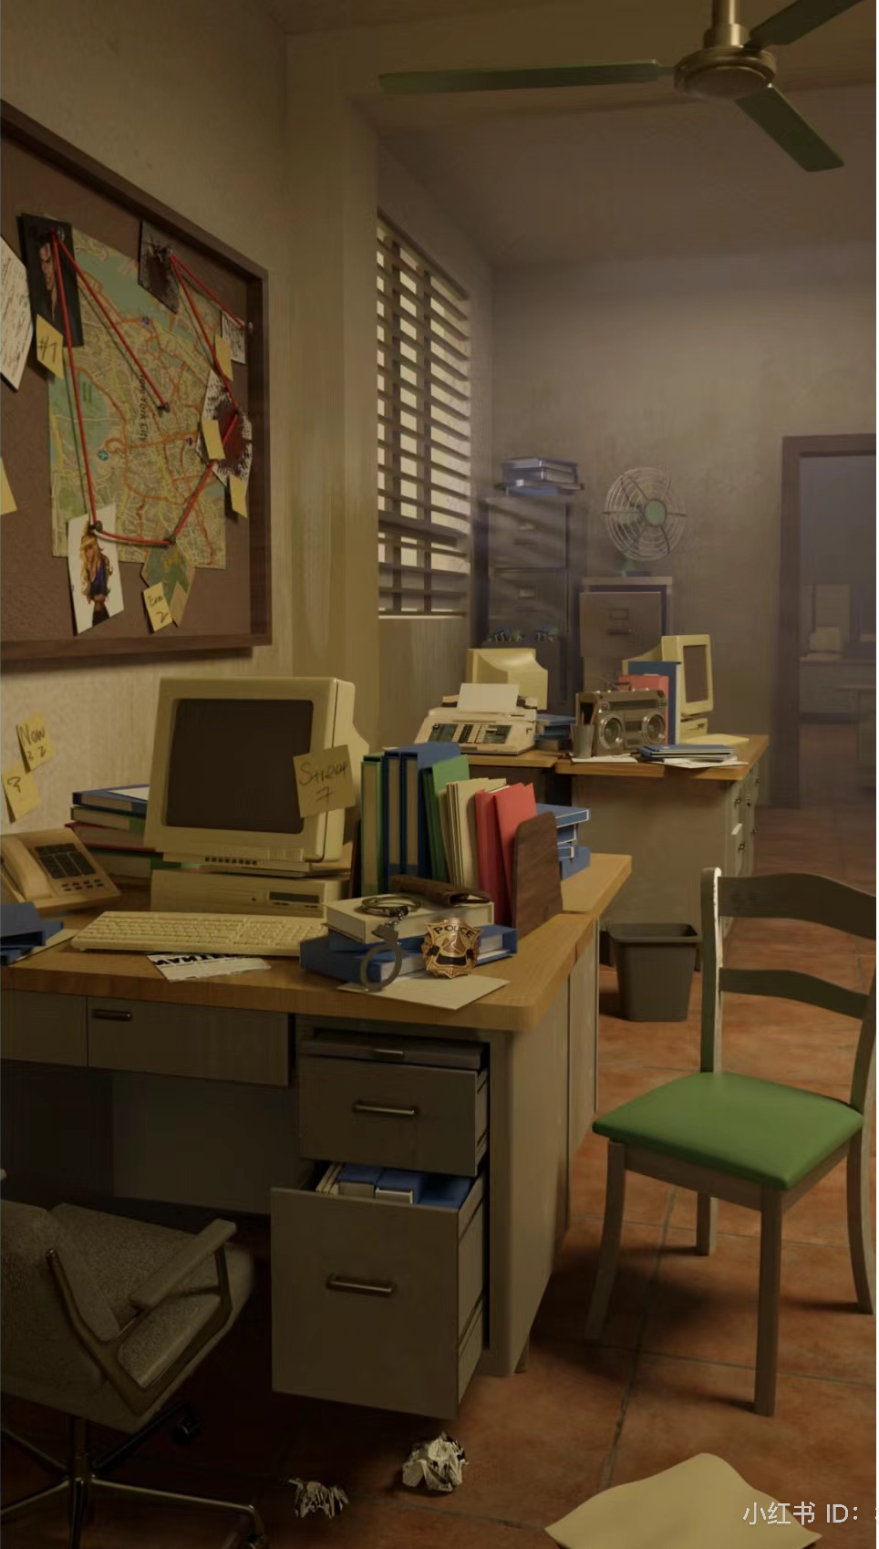
Colour

